Slide 1




Movies:
What factors affect their success?
Group- 9
David Kramer, Mojtaba Zadaskar, Yalda Alemi and Deepika Mehanti

Slide 3
The dataset: 2017 - 2022
The data was sourced from The Movie Database (TMDB) using their API (https://www.themoviedb.org/).
The data consists of all movies with budget data in the years 2017-2022. The complete data set has 15 columns and 15574 rows.
The fields collected are as follows:
TMDB ID
Original Title
Overview
Popularity
Release Date
Title
Vote Average
Vote Count
Budget
Revenue
Country
Original Language
Genre
IMDB ID

Slide 4
How is popularity calculated?
Number of votes for the day
Number of views for the day
Number of users who marked it as a "favourite" for the day
Number of users who added it to their "watchlist" for the day
Release date
Number of total votes
Previous days score

Slide 5
Initial Questions
Does budget affect popularity?
Does the Country of Origin affect popularity? Does Language?
Does director or cast affect the popularity?
Which countries produce the most content?
Which genre produces the most popular shows?
Is there a difference in what/how much is produced pre & post Covid?

Slide 6
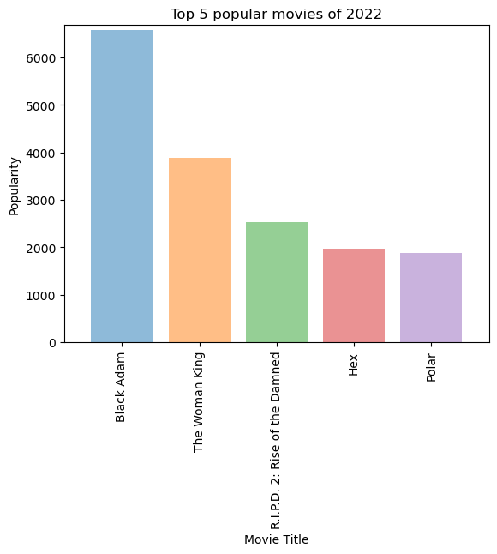
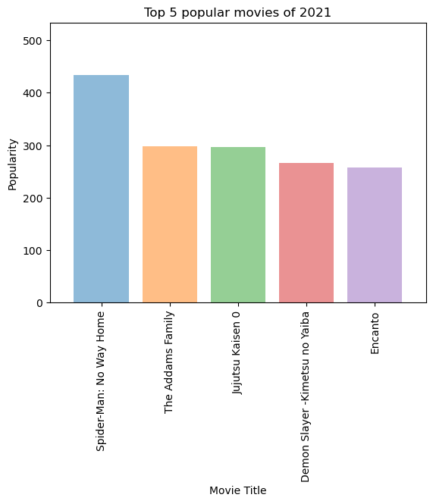
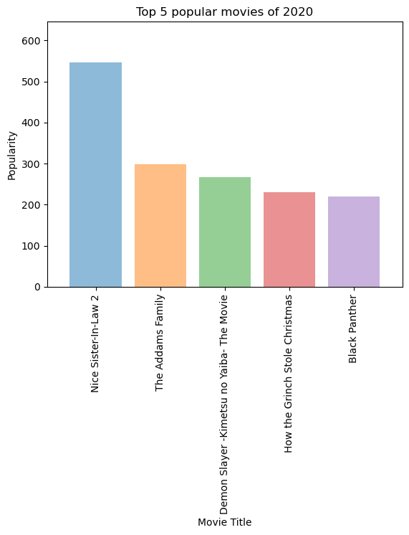
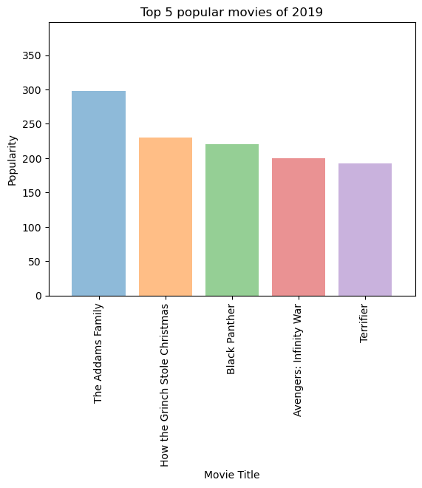
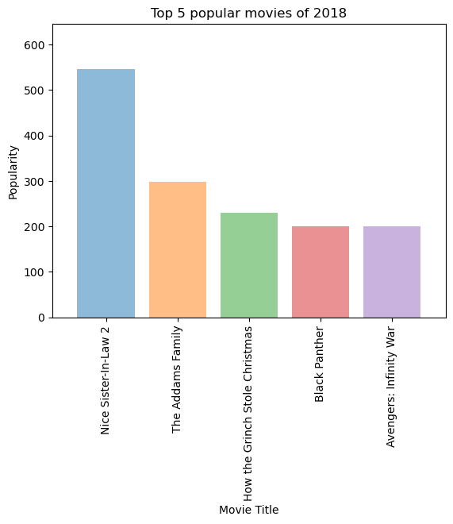
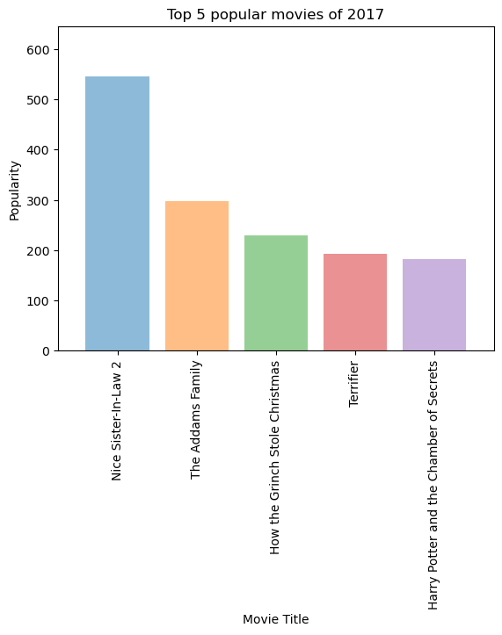
Top 5 Popular Movies
2017-2022
Movies which are consistently in Top 5 .
The Adams family 2017-2021.
How the Grinch stole Christmas 2017-2020.
Black Panther 2018-2020
Black Adam is leading in year 2022.

Slide 7
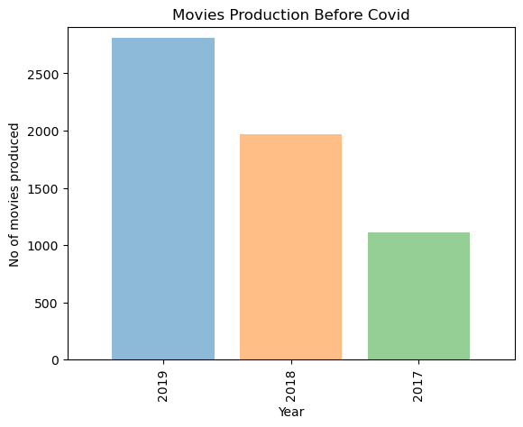
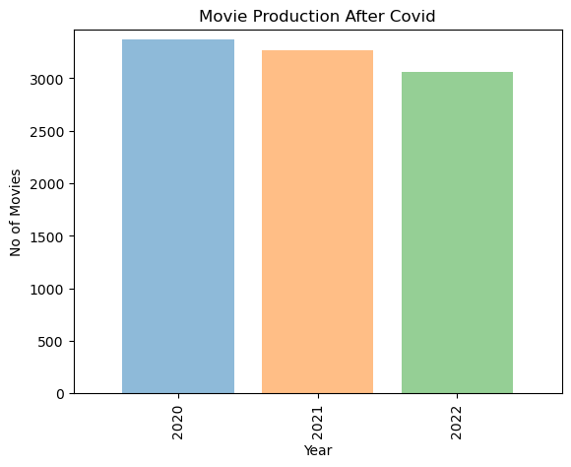
Movies Produced Before and After Covid-19
Movies Produced Before Covid -19
From Year 2020-2022
Movies Produced After Covid -19
From Year 2020-2022

Slide 8
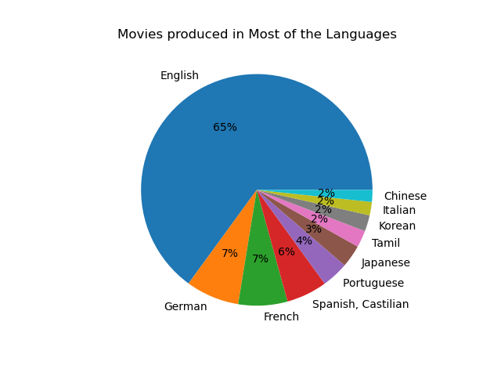
Movies Produced in Most Languages.
English
German
French
Spanish
Portuguese
Tamil
Korean
Italian
Chinese

Slide 9
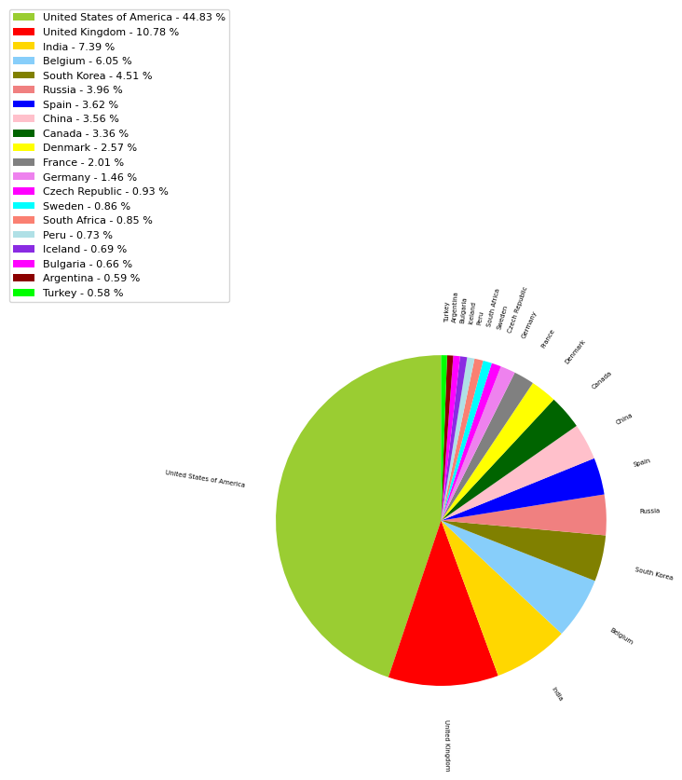
Popularity vs Country - 2017

Slide 10
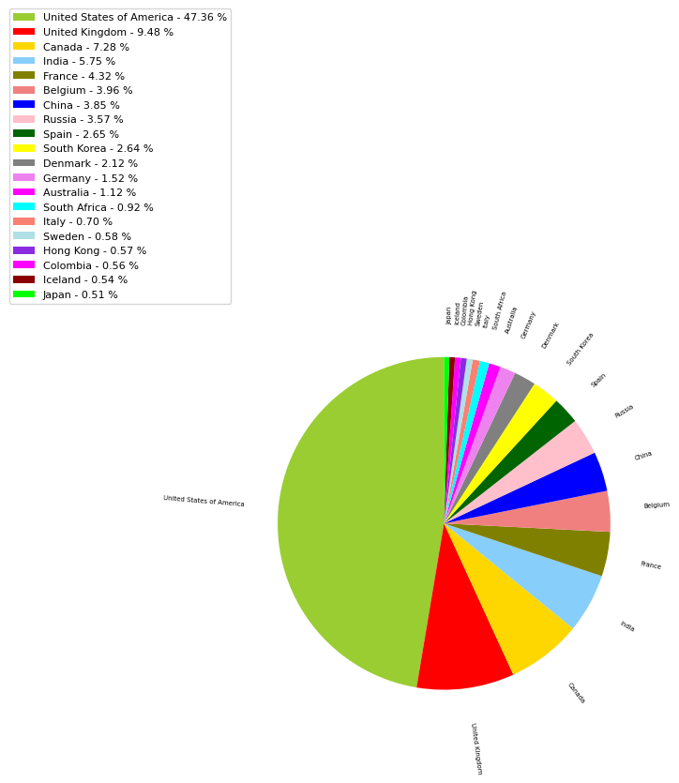
Popularity vs Country - 2018

Slide 11
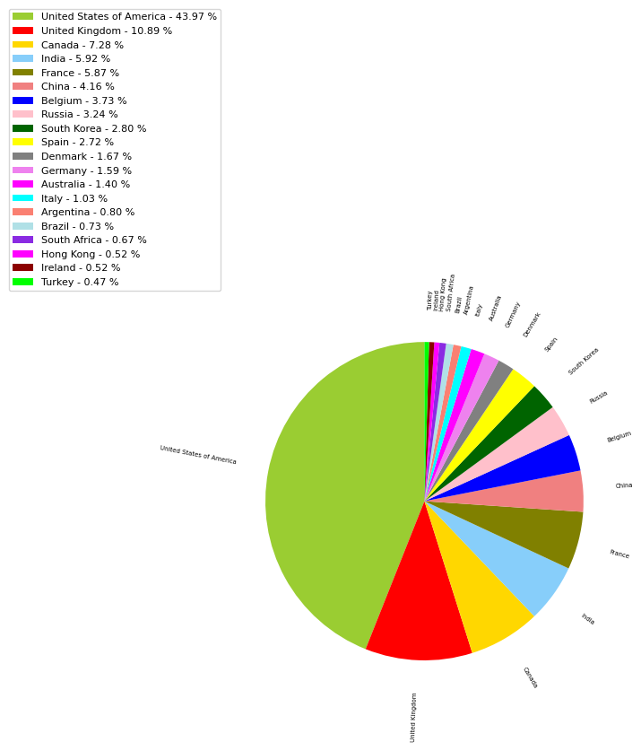
Popularity vs Country - 2019

Slide 12

Popularity vs Country - 2020

Slide 13
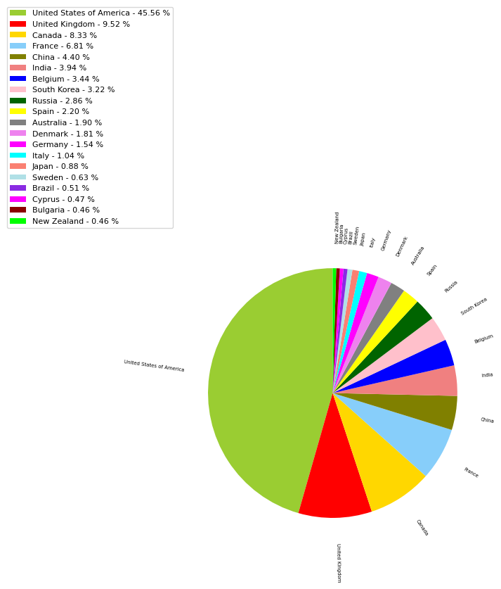
Popularity vs Country - 2021

Slide 14
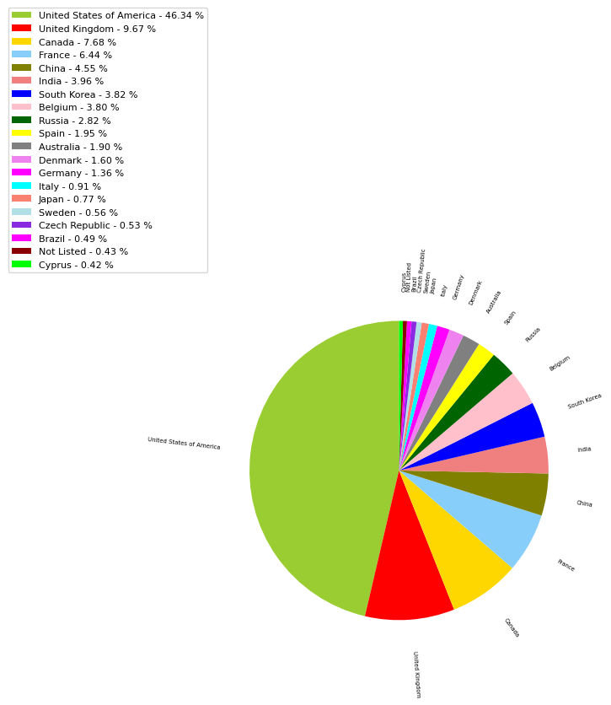
Popularity vs Country - 2022

Slide 15
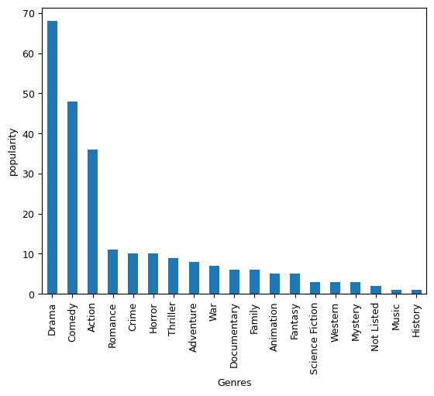
Popularity vs Genre - 2017

Slide 16
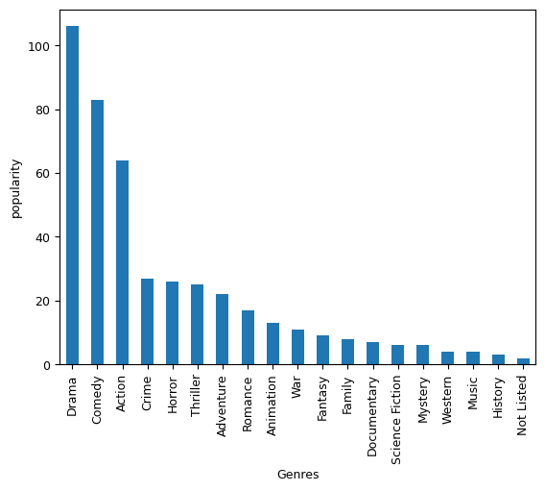
Popularity vs Genre - 2018

Slide 17
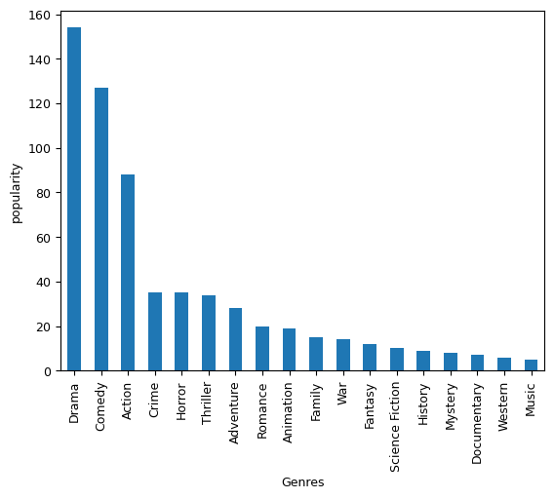
Popularity vs Genre - 2019

Slide 18
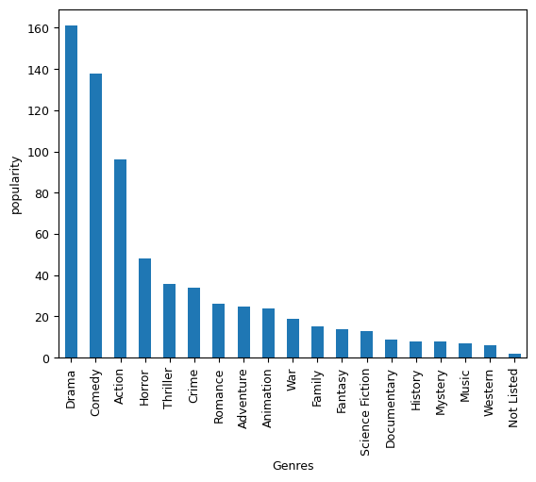
Popularity vs Genre - 2020

Slide 19
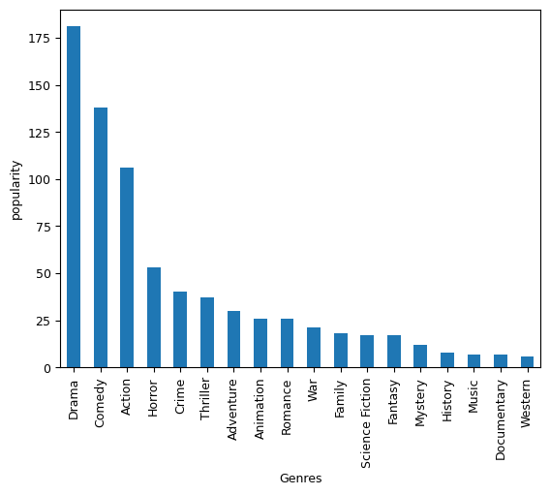
Popularity vs Genre - 2021

Slide 20
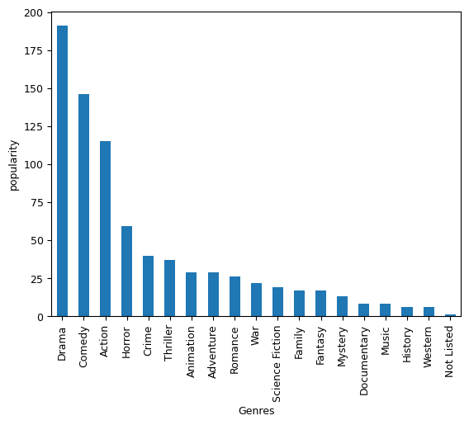
Popularity vs Genre - 2022

Slide 21
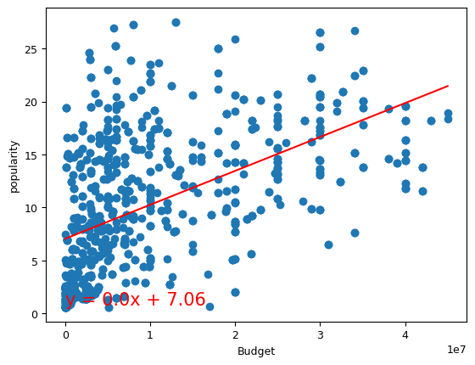
Popularity vs Budget - Precovid
The correlation between both factors is 0.52
The r-squared is: 0.2668004891145089

Slide 22
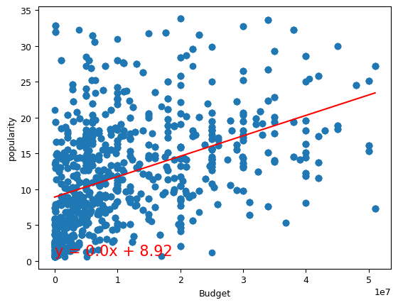
Popularity vs Budget - Covid
The correlation between both factors is 0.44
The r-squared is: 0.1972348316534791

Slide 23
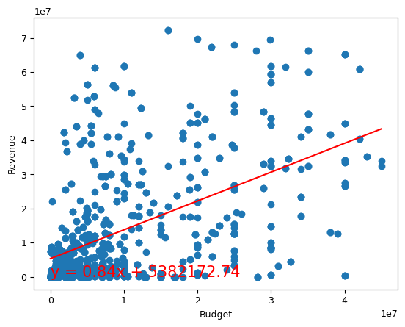
Revenue vs Budget - Precovid
The correlation between both factors is 0.53
The r-squared is: 0.28174111564286397

Slide 24
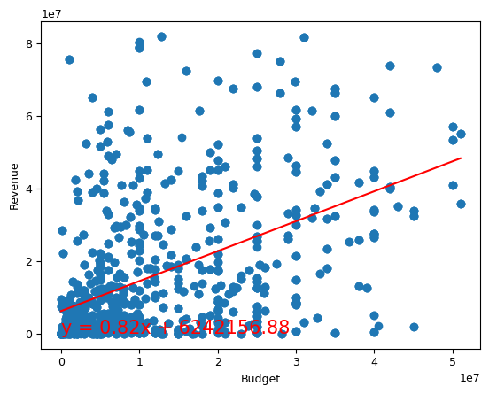
Revenue vs Budget - Covid
The correlation between both factors is 0.49
The r-squared is: 0.24269861129236264

